Slide 1
Capstone Project – 2
NYC Taxi trip prediction
Team Members
Roopesh Valluru
Shubham Sharma
Kapil Sharma

Slide 2
Problem Statement
Build a model that predicts the total ride duration of taxi trips in New York City. Your primary dataset is one released by the NYC Taxi and Limousine Commission, which includes pickup time, geo-coordinates, number of passengers, and several other variables.

Slide 3
Data Summary
The dataset consists of 11 columns and around 1.5 Million records
The dataset consists of 6 months of data of year 2016.
Main Features:
1. Vendor ID
2. Pickup and Dropoff Datetime
3. Passenger Count
4. Pickup and Dropoff Latitude and Longitudes
5. Store and forward flag
6. Trip Duration

Slide 4
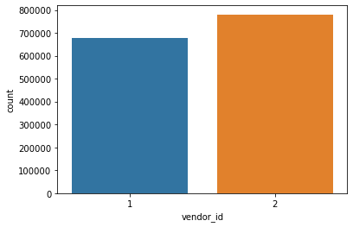
Describing the variables w.r.t to Dataset
Vendor ID

Slide 5
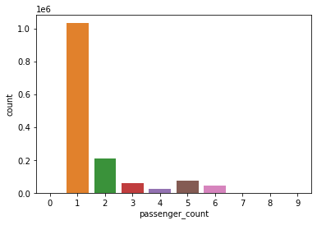
Passenger count

Slide 6
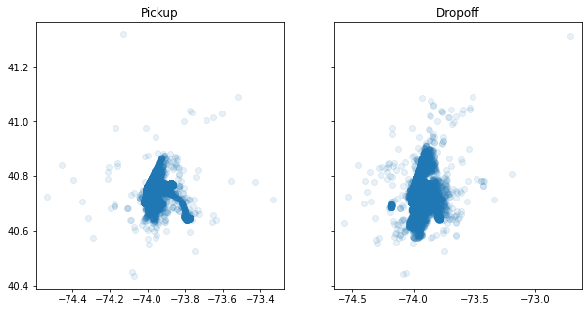
Pickup and Dropoff Latitude and Longitude

Slide 7

Store and forward flag

Slide 8
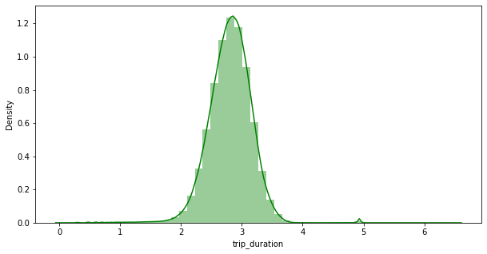
Trip Duration

Slide 9
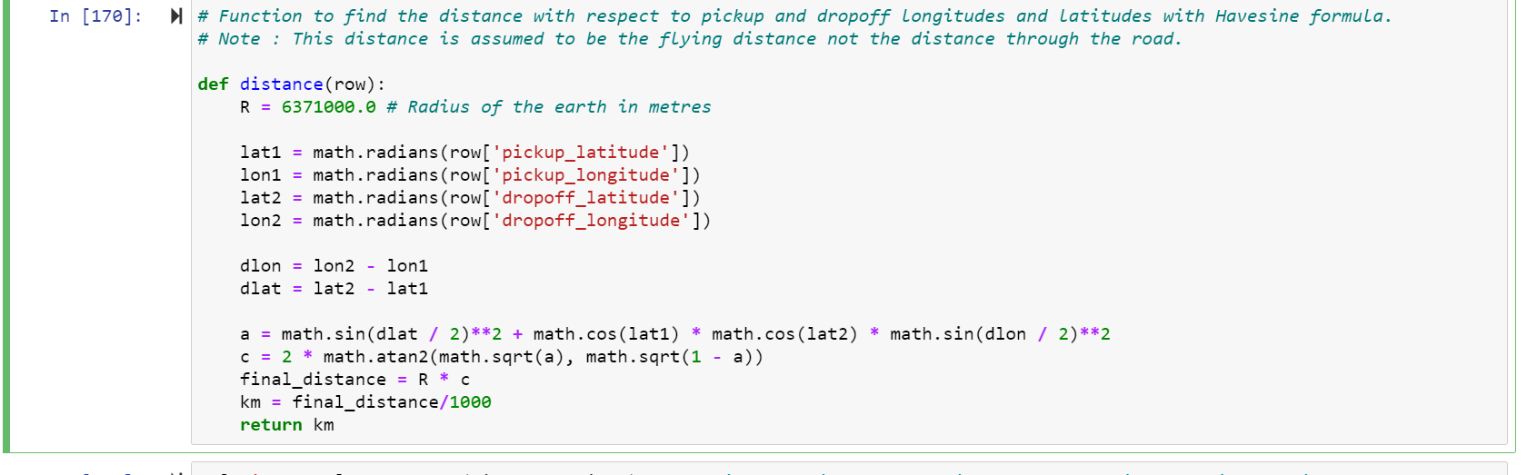
Feature Engineering
Creating Distance variable through feature engineering

Slide 10
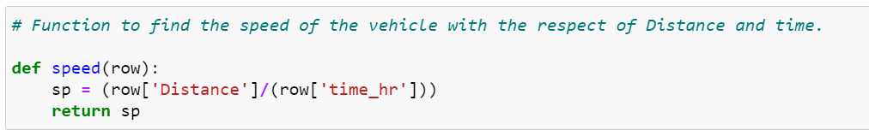
Speed

Slide 11
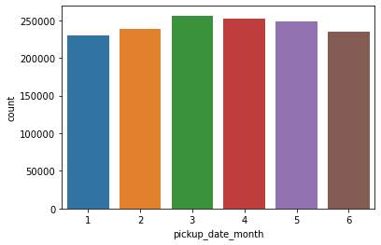
Explaining featured variables in updated dataset

Slide 12
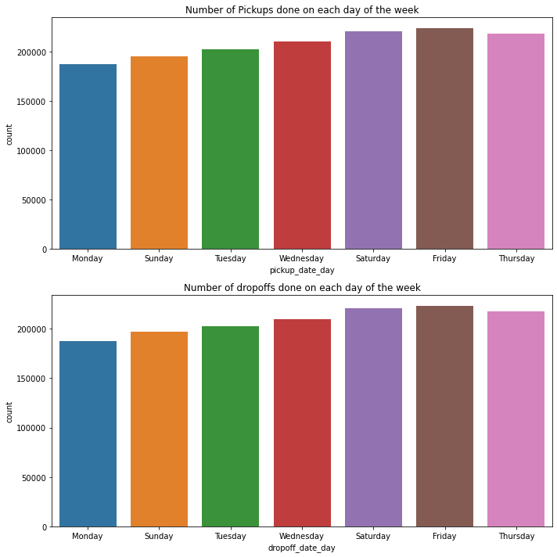
Updated dataset w.r.t Day in the week

Slide 13
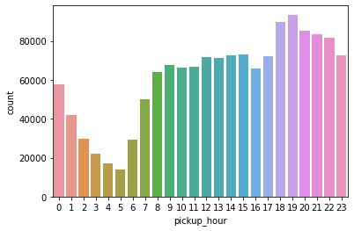
Updated dataset w.r.t hour

Slide 14
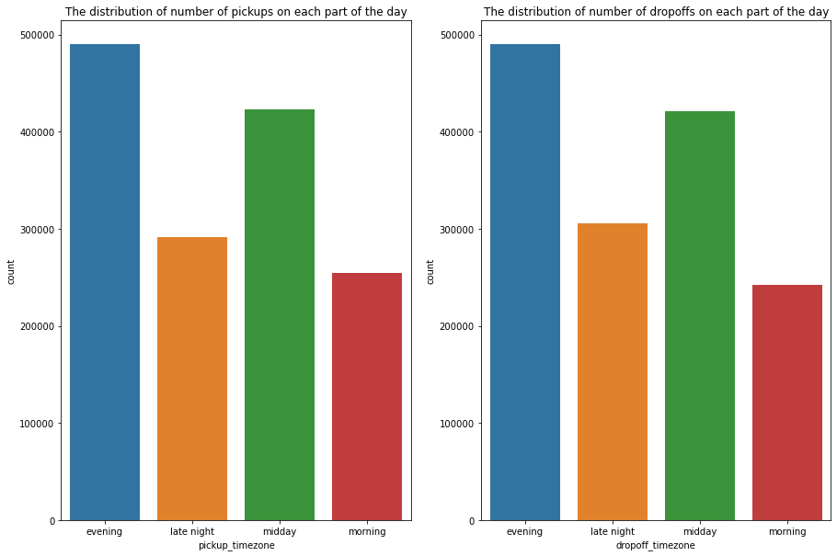
Analysis w.r.t time zone

Slide 15
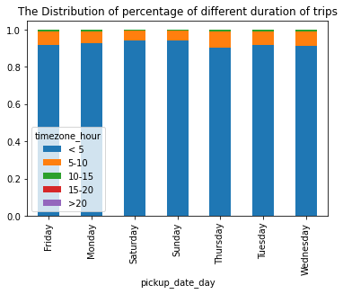
Analysing data w.r.t trip time

Slide 16
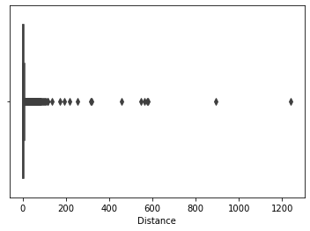
Distance

Slide 17
Data Cleaning
Assumptions made for the data cleaning:
1. Trips less than 200 meters and greater than 50 km are considered as outliers.
2. Trips taking more than 12 hours are also considered to be outliers.
3. Passenger count equal 0,7,8,9 are considered outliers.
In Distance feature column records which were treated as outliers w.r.t our assumption are replace with the mean of distance of the entire dataset which was 3.4 km.
In the process of cleaning the data around 31400 records were removed from 1.5 million records.

Slide 18
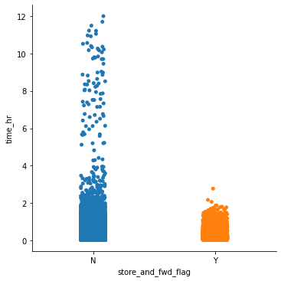
Time vs store and forward flag

Slide 19
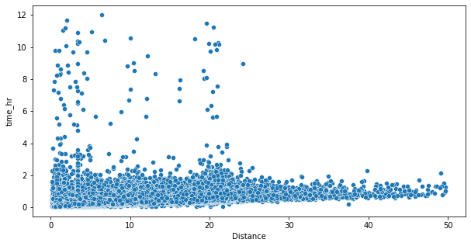
Time vs Distance

Slide 20
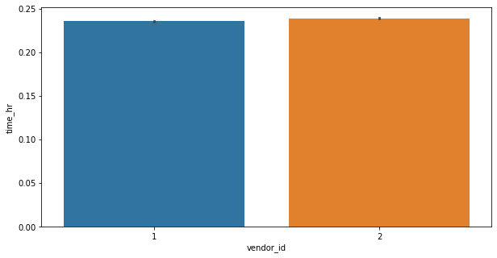
Time vs Vendor ID

Slide 21
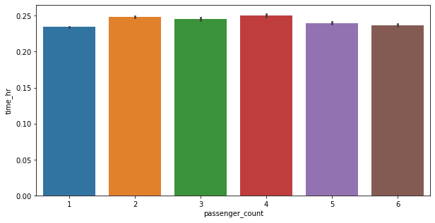
Time vs Passenger count

Slide 22
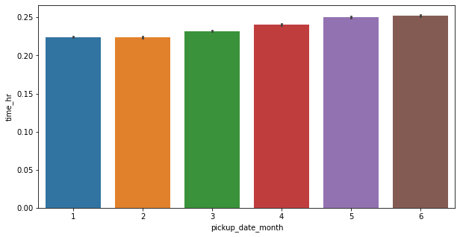
Time vs Month

Slide 23
Dummy Variables for regression
Features Selected:
1. Store and forward flag
2. Vendor ID
3. Month
4. Hours
5. Day
Dropping off the feature columns which were encoded and which don’t have any significance for the model.

Slide 24
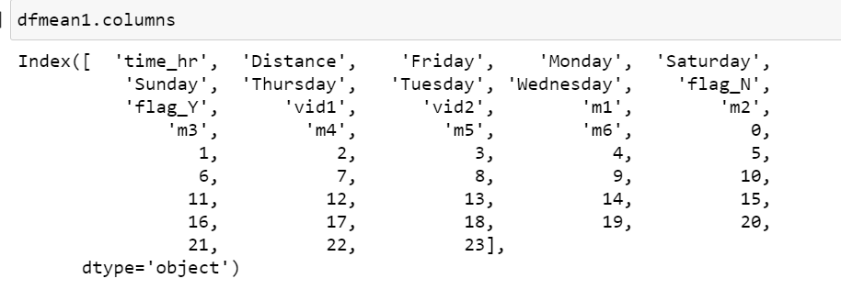
Data frame features for the model

Slide 25
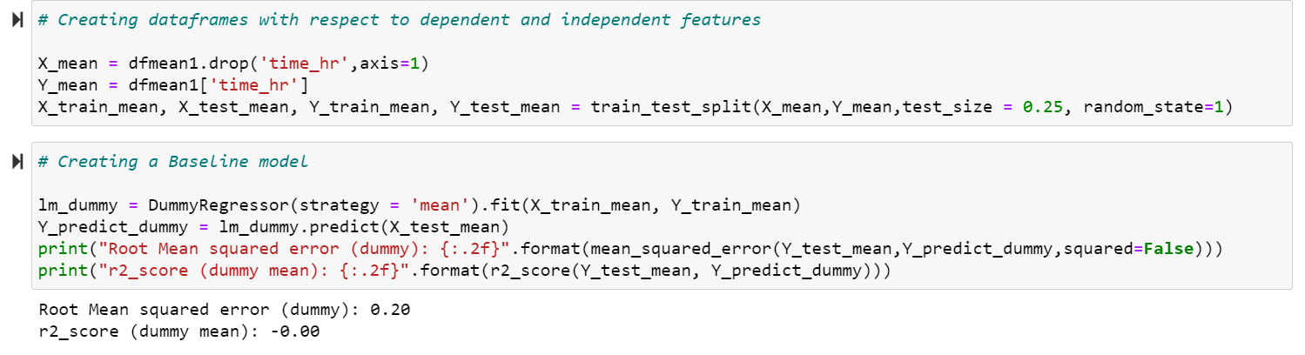
Baseline Model

Slide 26
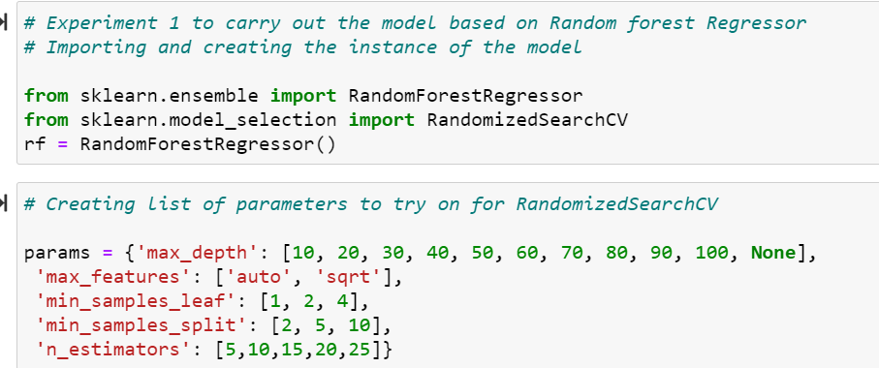
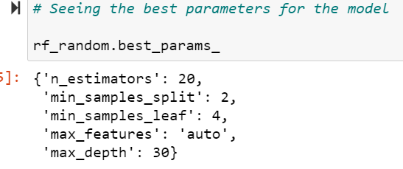
Random Forest Regressor

Slide 27
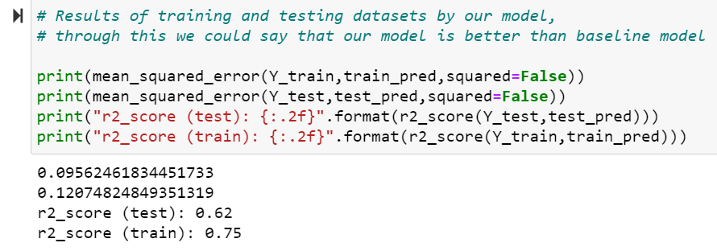
Random Forest Regressor

Slide 28
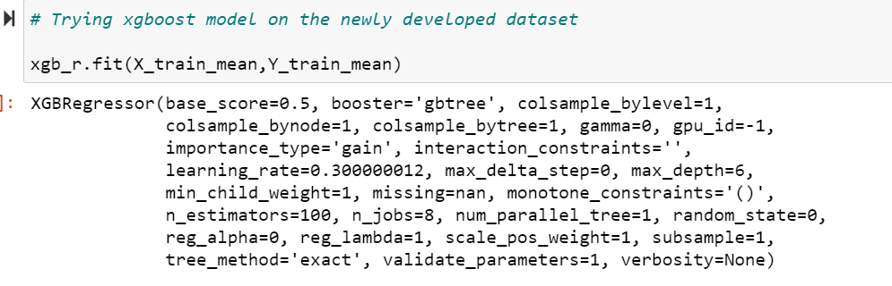
XGBoost Regressor

Slide 29
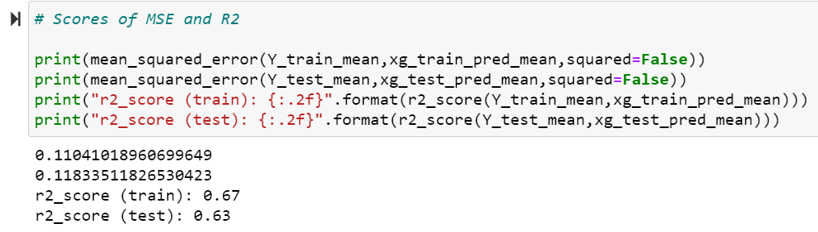
XGBoost Regressor

Slide 30
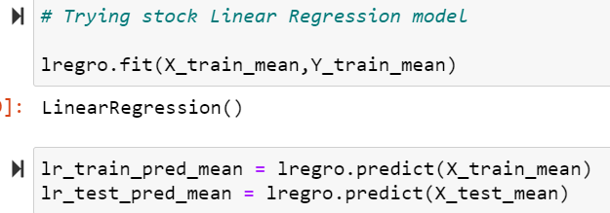
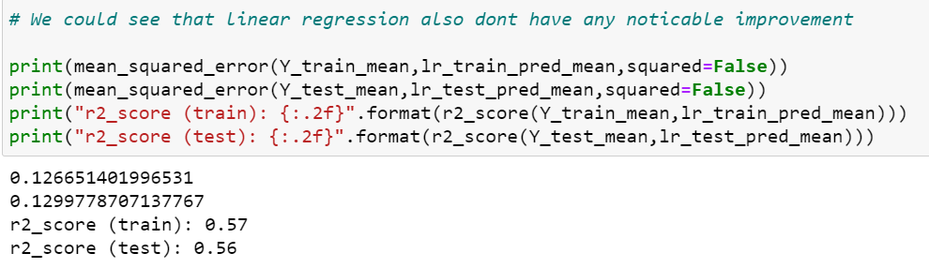
Linear Regression

Slide 31
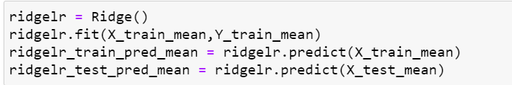
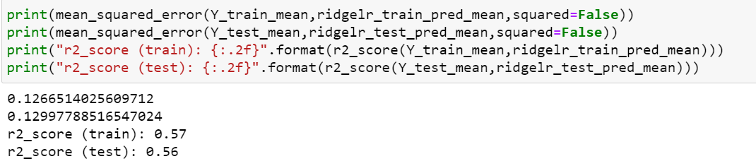
Linear Regression with Ridge

Slide 32
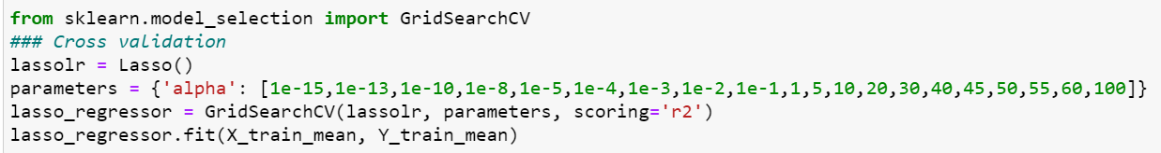

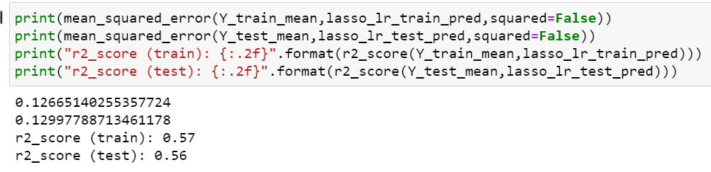
Linear Regression with Lasso

Slide 33
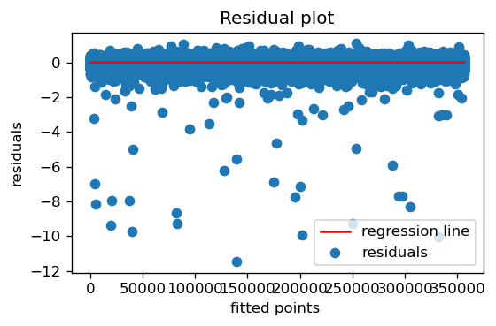
Homoscedasticity

Slide 34
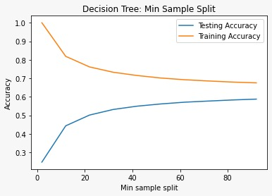
Decision Tree Regressor

Slide 35
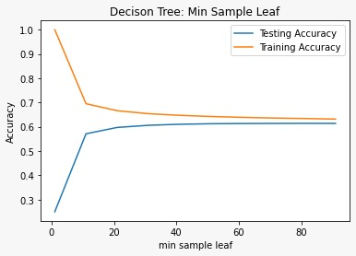
Decision Tree Regressor

Slide 36
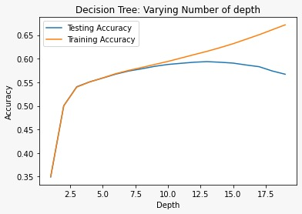
Decision Tree Regressor

Slide 37
Challenges
Huge dataset took too much time to train due to limited computational capacity.

Slide 38
Conclusions

Slide 39
Further Improvements
Hyperparameters can be tuned further for algorithms that require more computational power

Slide 40
Q & A

